Slide 1
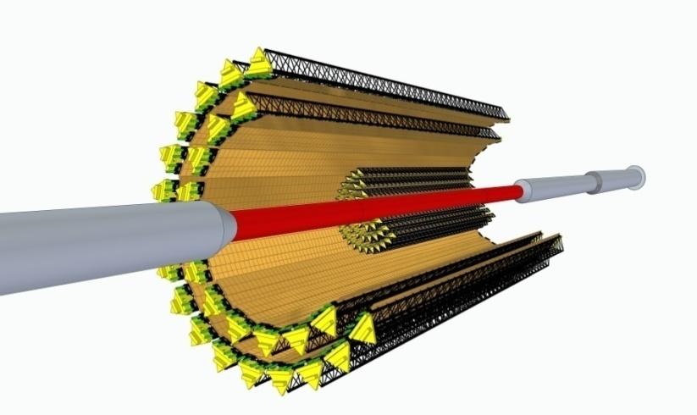
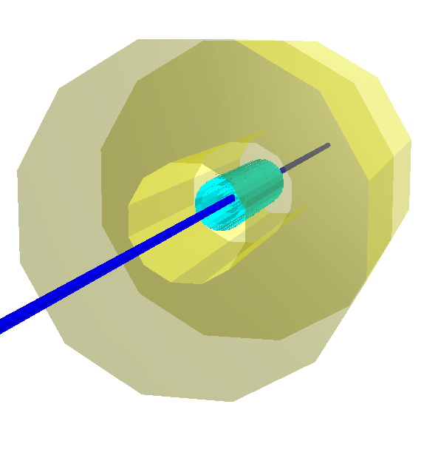
Heavy-flavor studies with MPD
MPD is being constructed to study the properties of extremely dense nuclear matter formed in relativistic nucleus-nucleus collisions at NICA energies. The yields and spectra of charmed particles are the important observables sensitive to critical phenomena in phase transitions of the QCD-matter. So, a vertex detector (Inner Tracker IT) is required for efficient detection of such short-lived products of nuclear interactions. The detector based on MAPS (Monolitic Active Pixel Sensors) technology is under consideration.
Particle | Mass [MeV/c²] | Mean path сτ [mm] | Decay channel | BR
D⁺ | 1869.62±0.20 | 0.312 | π⁺ + π⁺ + K⁻ | 9.1%
D⁰ | 1864.84±0.17 | 0.123 | π⁺ + K⁻ | 3.9%
D_{S}⁺ | 1968.47±0.33 | 0.150 | π⁺ + K⁺ + K⁻ | 5.2%
Λ_{C}⁺ | 2286.46±0.14 | 0.060 | π⁺ + p + K⁻ | 5.0%
Detector layers
Beam pipe
TPC
IT
1
Notes:
1

Slide 2
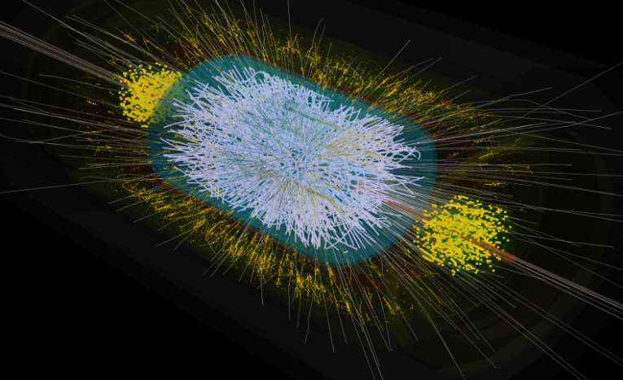
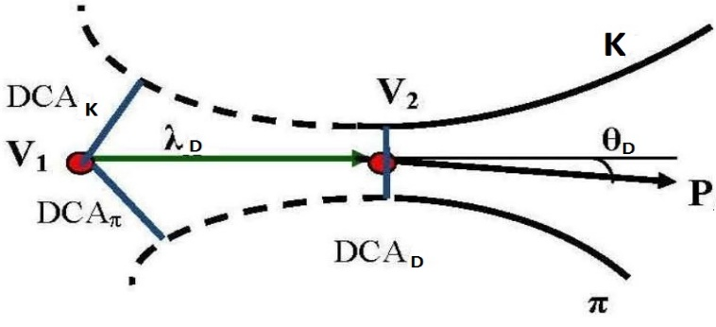
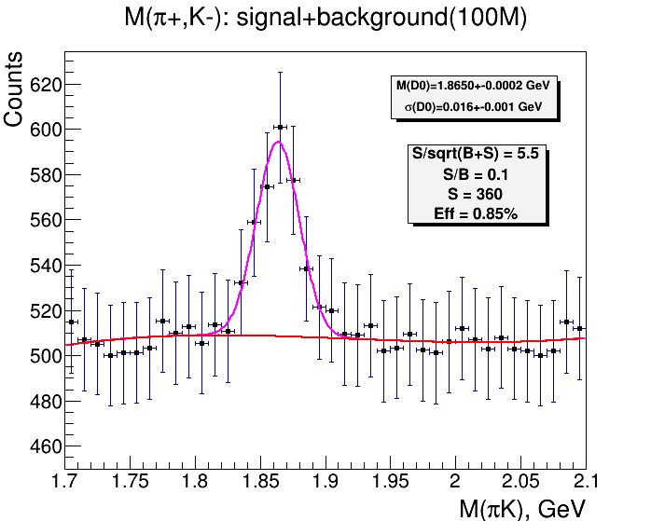
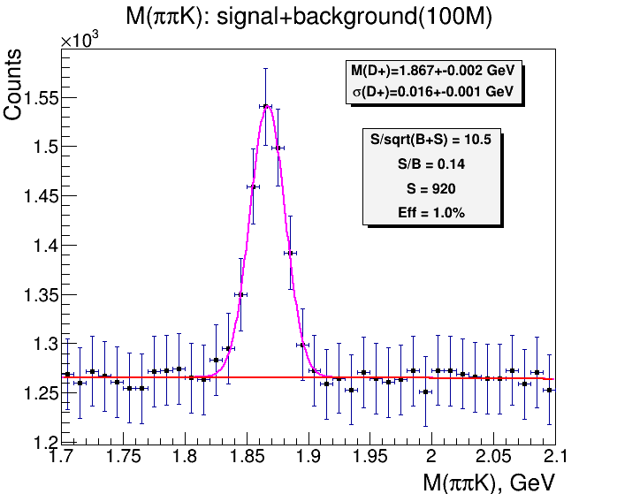
Open charm reconstruction, Au+Au at $\sqrt{s_{NN}}$= 9 GeV
To suppress the large combinatorial background in Au+Au collisions it is necessary to use strong criteria for signal selection. Two methods are used for signal selection:
Method of topological cuts (TC)
Method of multivariate data analysis (MVA)
Optimized selection cuts allow reconstructing D⁰ and D⁺ with an efficiency of 0.85% and 1.0%
Notes:
2

