Slide 1
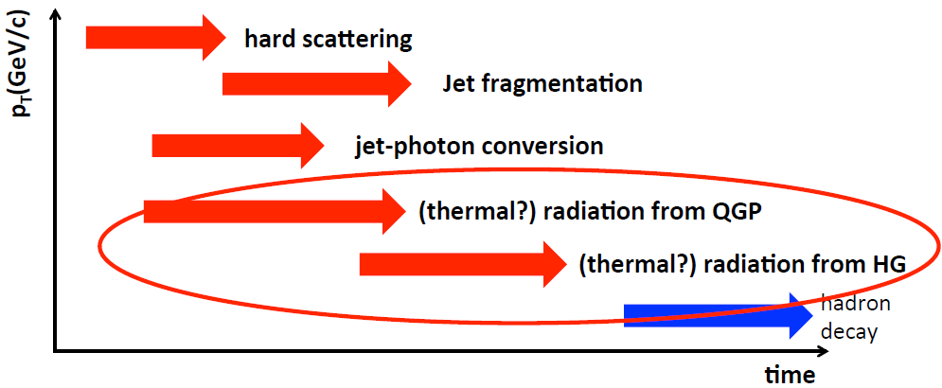
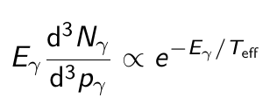
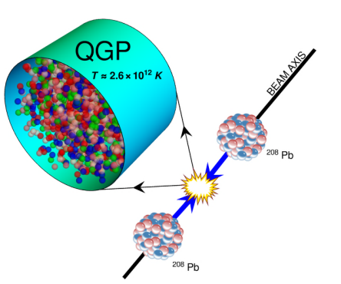
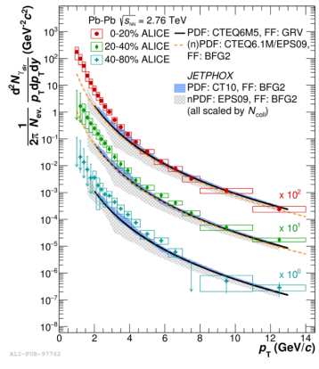
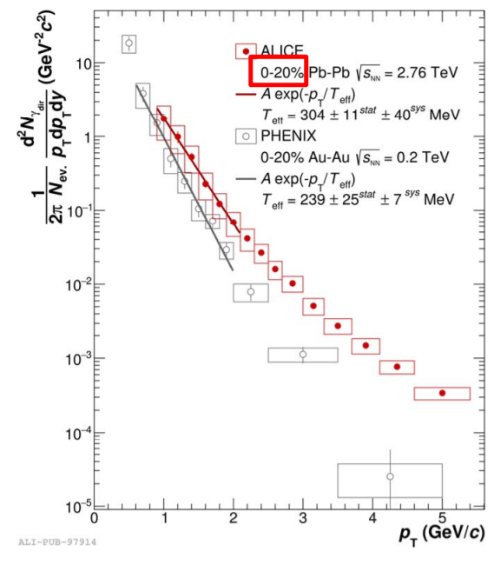
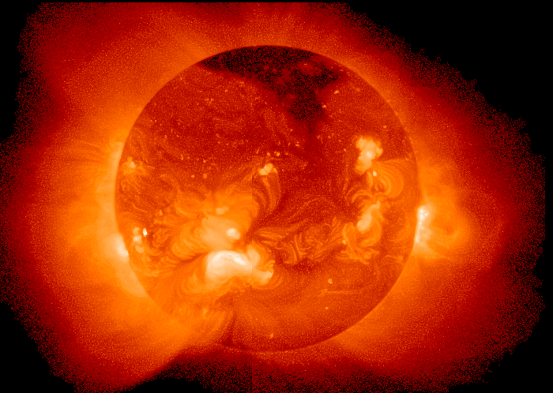
Direct photons and system temperature
Direct photons are all photons except for those coming from hadron decays:
produced during all stages of the collision
QGP is transparent for photons → penetrating probe
Low-E photons → effective temperature of the system:
Relativistic A+A collisions → the highest temperature created in laboratory ~ 10¹² K
Temperature at the center of the Sun ~ 15 000 000 K
T_{eff} ~ 240 MeV at RHIC; T_{eff} ~ 300 MeV at the LHC
T_{eff} >> T_{c} ~ 150 MeV predicted by LQCD
A medium of ~ 200 MeV is 100 000 times hotter !!!

Slide 2
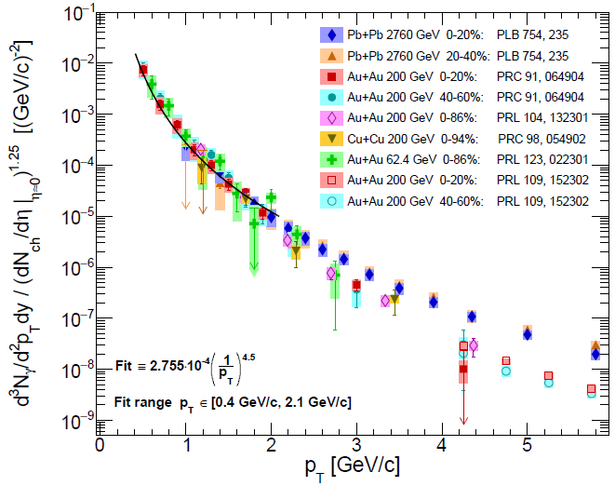
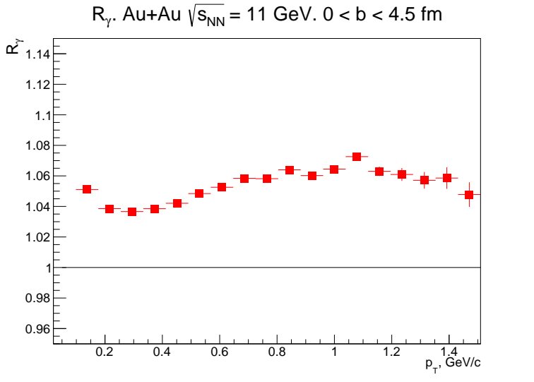
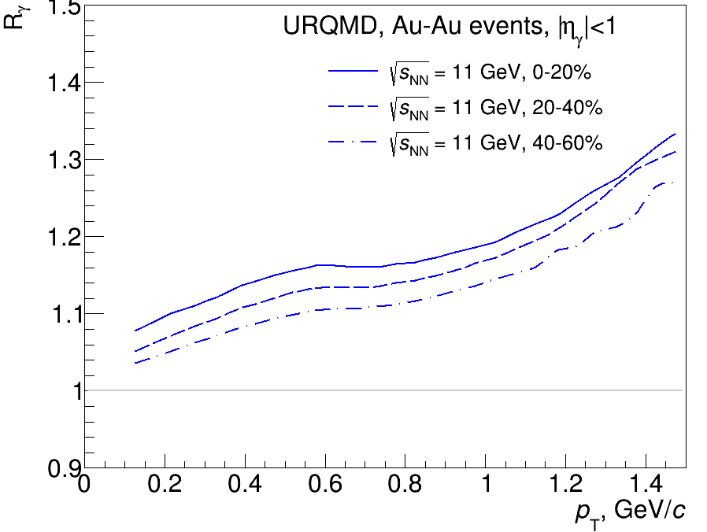
Embedded simulation for η
Predictions for NICA energies
Experimental measurements in A+A collisions are available from the LHC (2.76-5 TeV), RHIC (62-200 GeV) and WA98 (17.2 GeV)
No measurements at NICA energies (direct photon yields and flow vs. p_{T} and centrality)
Estimation of the direct photon yields @NICA
model
calculations
empirical scaling
UrQMD v3.4 with hybrid model (3+1D hydro, bag model EoS, hadronic rescattering and resonances within UrQMD)
Each cell have Ti, Ei, μbi:
T is high – QGP phase (Peter Arnold, Guy D. Moore, Laurence G. Yaffe, JHEP 0112:009 2001)
T is low – HG phase (Simon Turbide, Ralf Rapp, Charles Gale, Phys.Rev.C69:014903,2004)
T is intermediate – mixed phase
Integrate over all cells and all time steps
Calculations reproduce hydro calculations for the SPS
AuAu@11, 0 < b < 4.5 fm
prompt photons are not included
Non-zero direct photon yields are predicted, Rγ ~ 1.05 – 1.15 → experimentally reachable by MPD!!!

Slide 3
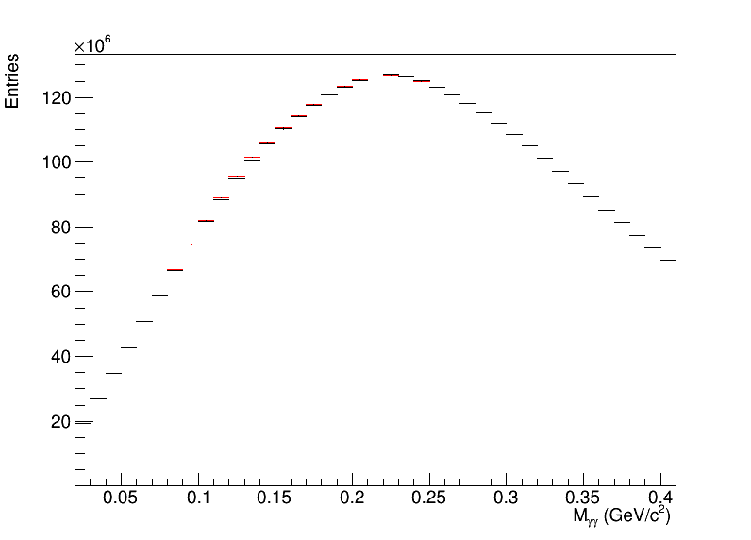
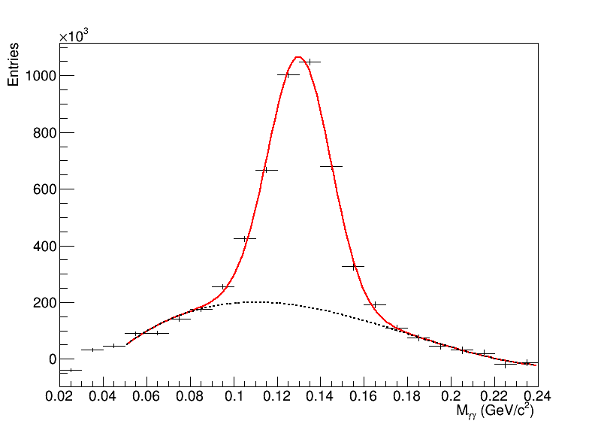
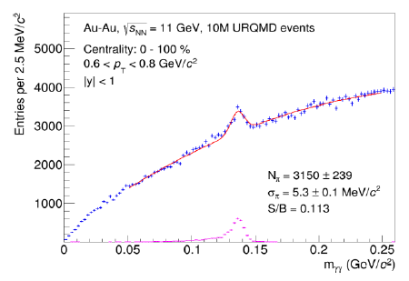
Neutral mesons in heavy-ion collisions
Wide variety of neutral mesons:
π⁰ (π⁰→ γγ)
η (η → γγ, η → π⁰ π⁺ π)
K_{s} (K_{s}→ π⁰ π⁰)
ω (ω → π⁰ γ, ω → π⁰ π⁺ π)
η’ (η’ → η π⁺ π)
Neutral mesons are of great interest:
complementary measurements to identified charged hadrons with different systematics
collective flow, parton recombination and energy loss, strangeness production etc. probed with particles of different masses, quark contents/counts
dominant background for other observables such as direct photons, e_{HF} and di-electrons
Neutral mesons are measurable with photon reconstruction in ECAL and photon conversion (γ → e⁺e⁻)
ECAL
Photon conversion
Au-Au, $\sqrt{s_{NN}}=$11 GeV, 10M URQMD events
Centrality: 0-100%, 0.3 < pT < 0.6 GeV/c, |y| < 1
π⁰(η) → γ (γ → e⁺e⁻) + γ (γ → e⁺e⁻)
No background subtraction needed
Foreground
Mixed event background

Slide 4
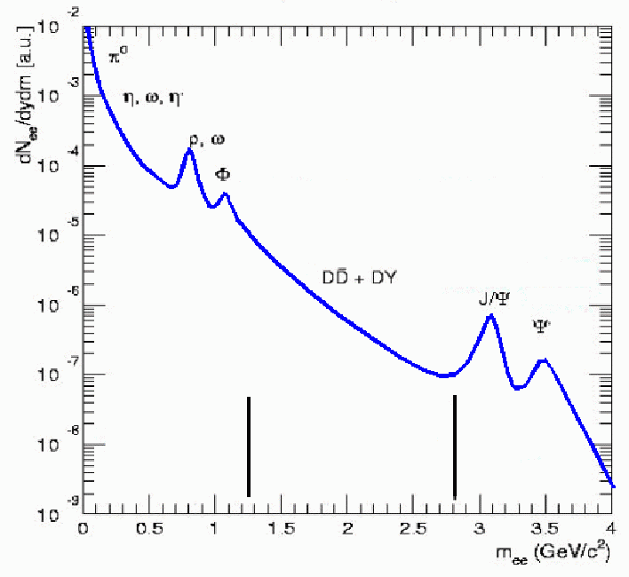
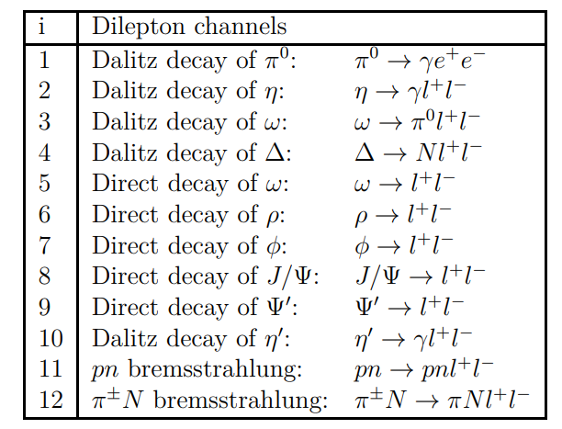
Photon energy resolution
Dielectron continuum and LVMs
The QCD matter produced in A-A interactions is transparent for leptons, once produced they leave the interaction region largely unaffected
Dielectron continuum at low and intermediate mass/p_{T} carries a wealth of information about reaction dynamics and medium properties:
Mass (Lorentz-invariant): not sensitive to collective expansion
Low-mass part sensitive to late (hadronic) stage, intermediate mass — to hot stage
ρ-meson peak: modification of ρ-meson properties in hot matter (chiral phase transition)
charm production and correlations etc.
Low-mass region:
CSR
In-medium modification of LVM
HG thermal radiation
Intermediate mass region:
Charm in-medium modification
QGP thermal radiation
cc suppression
Low
Intermediate
High
m_{ee} (GeV/c²)

Slide 5
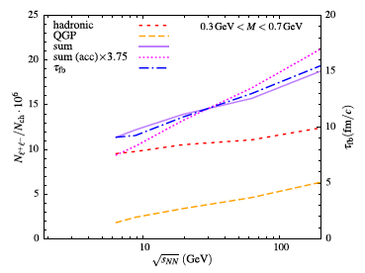
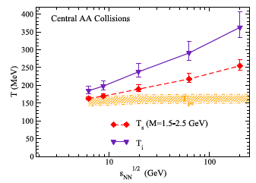
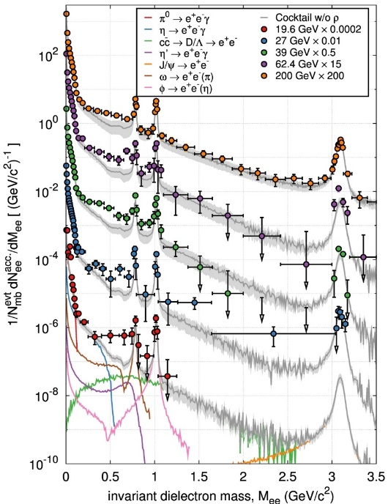
Photon energy resolution
Available measurements and expectations
Expectations (PLB 753, 586 (2016)):
Integrated yield in the LMR → fireball lifetime
Inverse slope of the mass spectrum in the IMR → measurement of T
Beam energy scan program by STAR at RHIC (PRL 113, 22301 (2014); PRC 92, 24912 (2015)):
LMR:
clear enhancement wrt to hadronic cocktail of known sources
small centrality dependence
observed at all energies down to 19.6 GeV
IMR:
no clear picture
MPD → extensive program of dielectron measurements in the NICA energy range, $\sqrt{s_{NN}}$= 4-11 GeV

