Slide 1
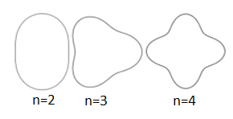
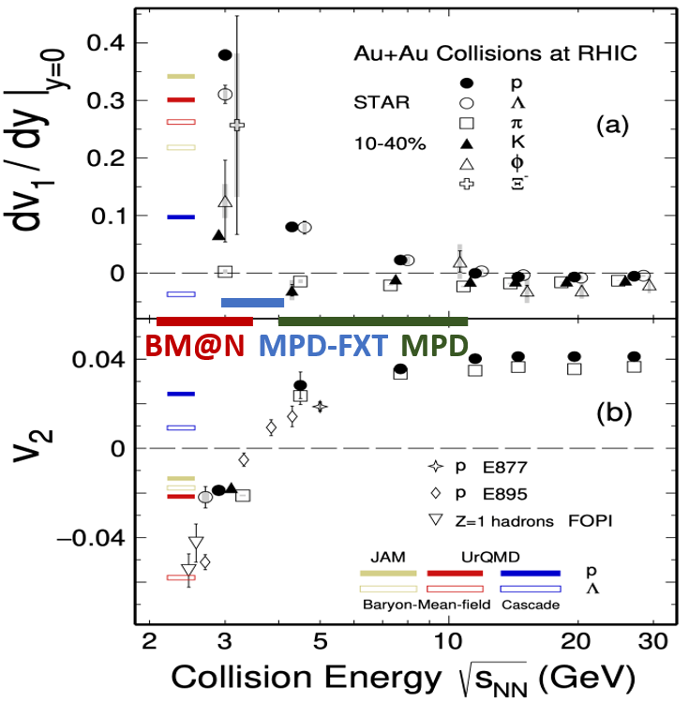
Anisotropic flow
Initial eccentricity and its fluctuations drive momentum anisotropy v_{n} with specific viscous modulation
Spatial anisotropy of the nuclear overlap region
Azimuthal distribution of produced particles wrt to reaction plane ($Ψ_{n}$)
$$ε_{n}∝v_{n}$$
b
Anisotropic flow: $v_{n}=\left\langle \cos\left[n\left(φ−Ψ_{n}\right)\right]\right\rangle$
Phys.Lett.B 827 (2022) 137003
Collective flow at NICA energies is sensitive to:
compressibility of the created in the collision matter ($t_{exp}=R/{c_{s}}, c_{s}=c\sqrt{{dp}/{dε}}$)
time of the interaction between the overlap region and spectators ($t_{pass}= {2R}/{γ_{CM}β_{CM}}$)
Collective flow at NICA energies:
v₁ and v₂ show strong centrality, energy and species dependence
models do not quite reproduce the measurements

Slide 2
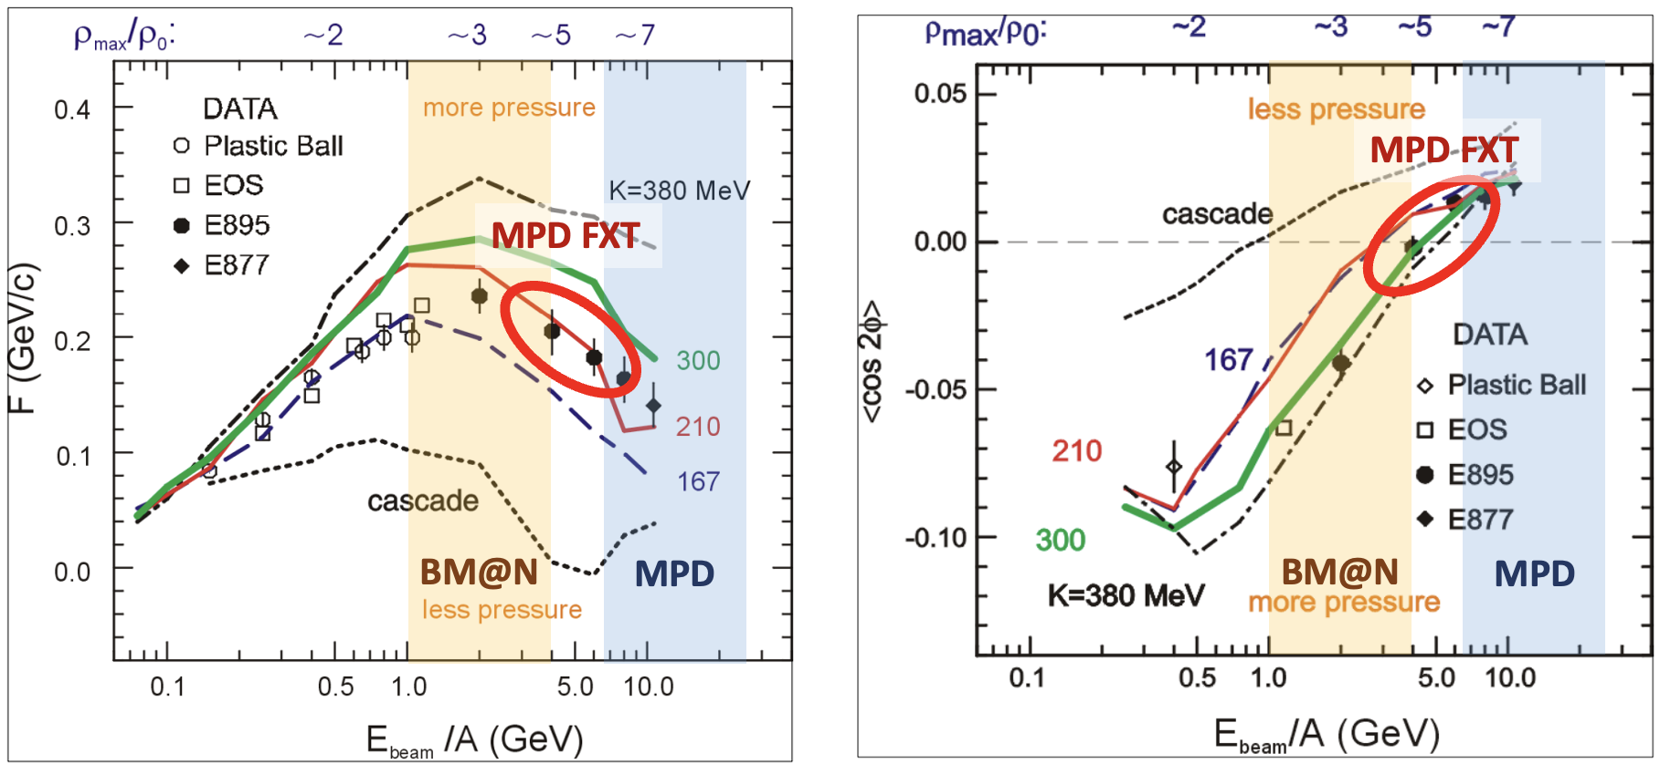
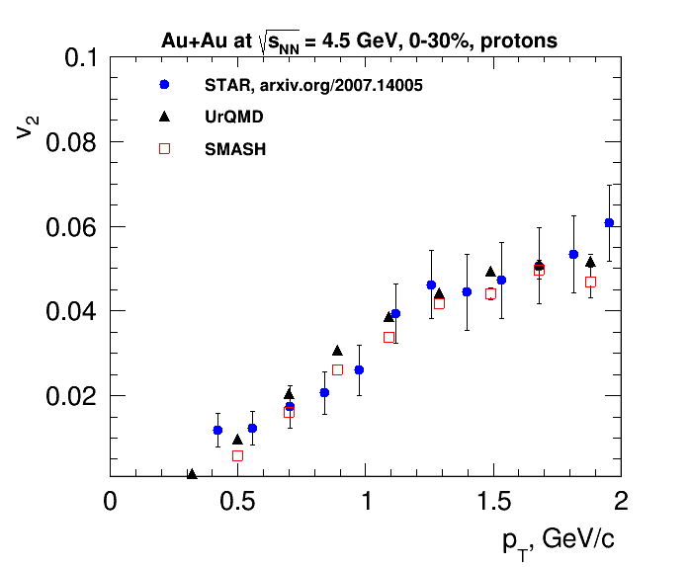
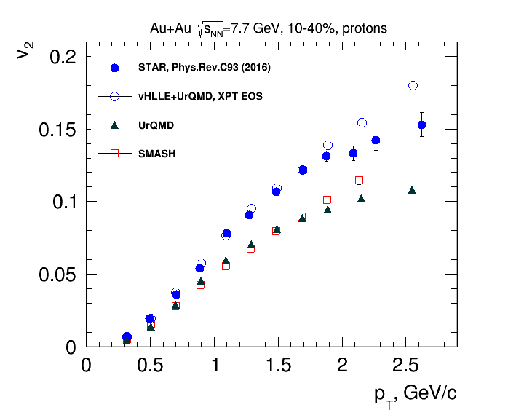
Constraining models
Flow measurements are used to extract information about equation of state
Science 298 (2002) 1592-1596
Flow is sensitive to degrees of freedom in the produced medium
$\sqrt{s_{NN}}$ ~ 3-4.5 GeV, pure hadronic models reproduce v₂ (JAM, UrQMD) → degrees of freedom are the interacting baryons
$\sqrt{s_{NN}}$ ≥ 7.7 GeV, need hybrid models with QGP phase (vHLLE+UrQMD, AMPT with string melting,…) to describe the measurements
Existing results are ambiguous – more experimental data is needed:
flow measurements as a function of p_{T} , rapidity and particle species → test of modeling approaches, microscopic degrees of freedom
collision system scan → vary the initial condition and observe its influence for the final state

Slide 3
MPD feasibility studies: v_{n} measurements
BiBi@9.2 GeV (UrQMD), collider mode → full event/detector simulation and reconstruction
Good performance for v₁, v₂ using different methods for flow measurements
Reconstructed and generated v₂ of pions and protons are in good agreement for all methods
MPD has good capabilities for differential measurements of anisotropic flow for identified hadrons

Slide 4
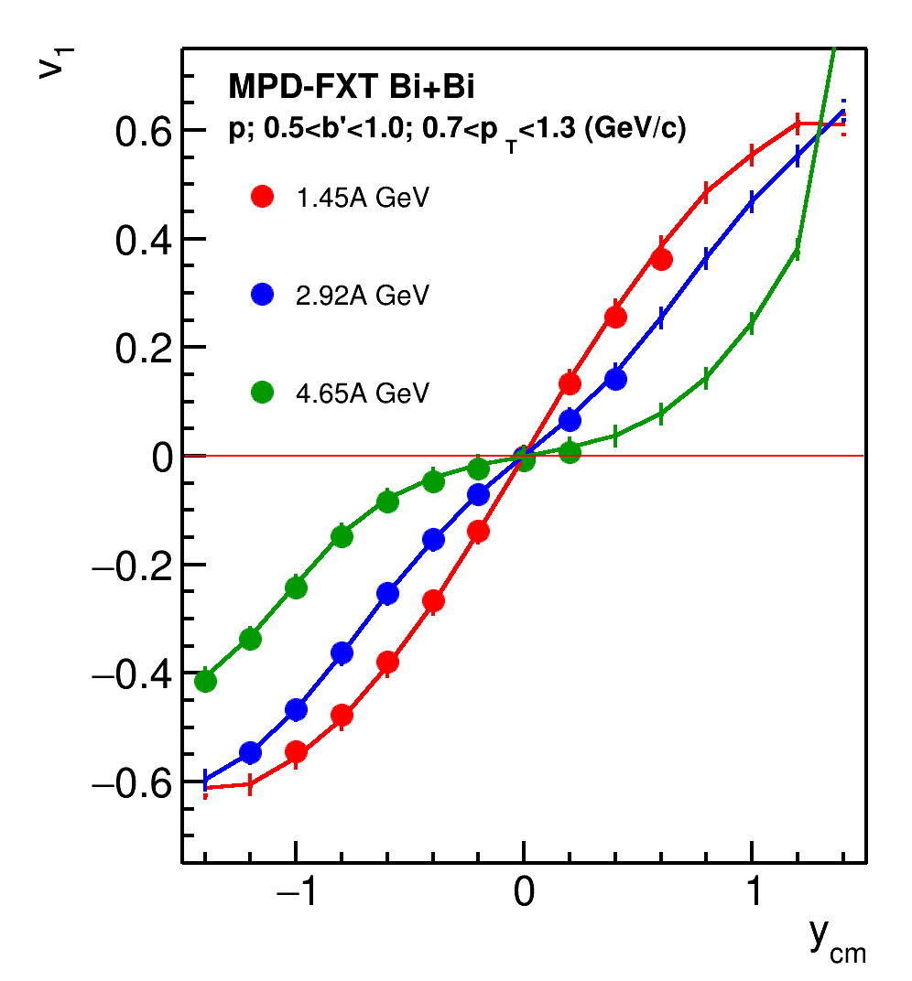
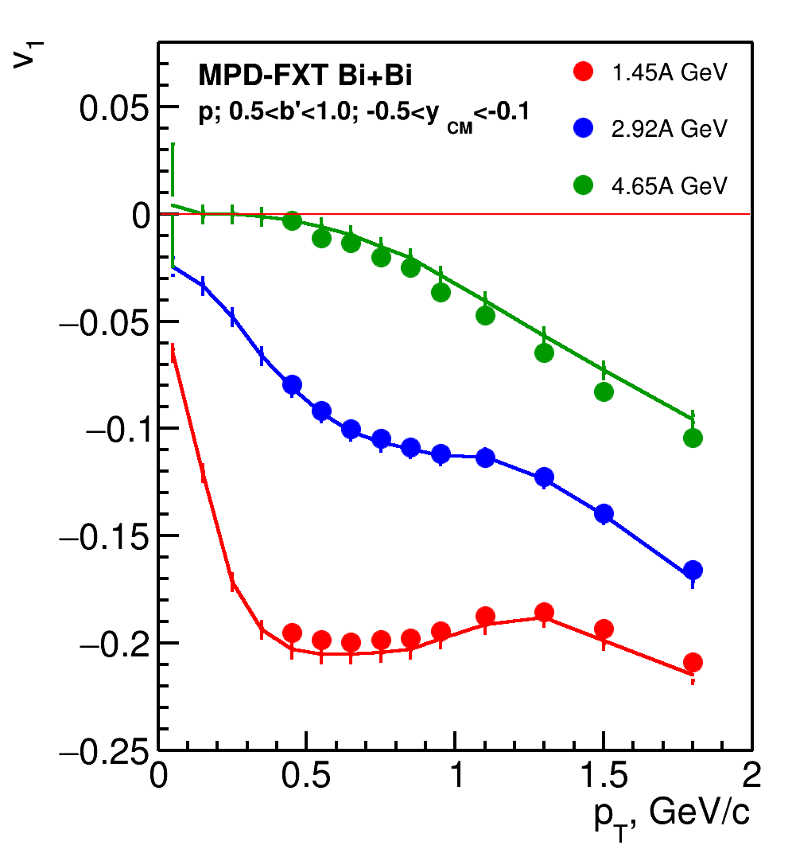
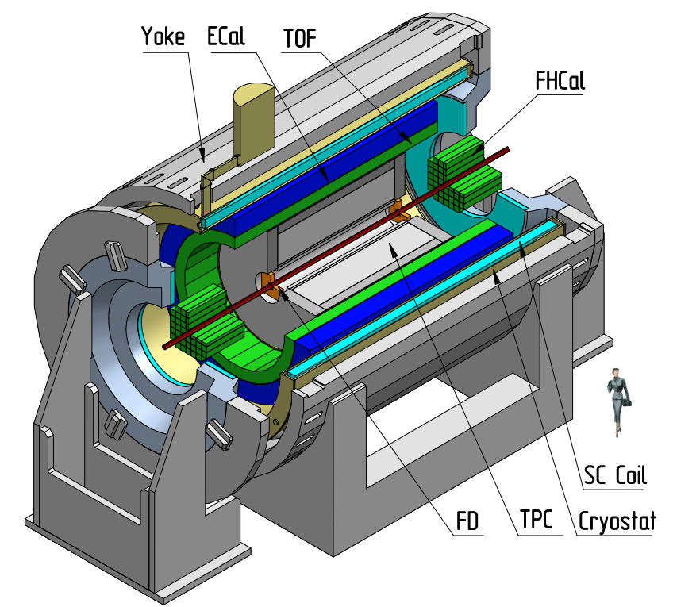
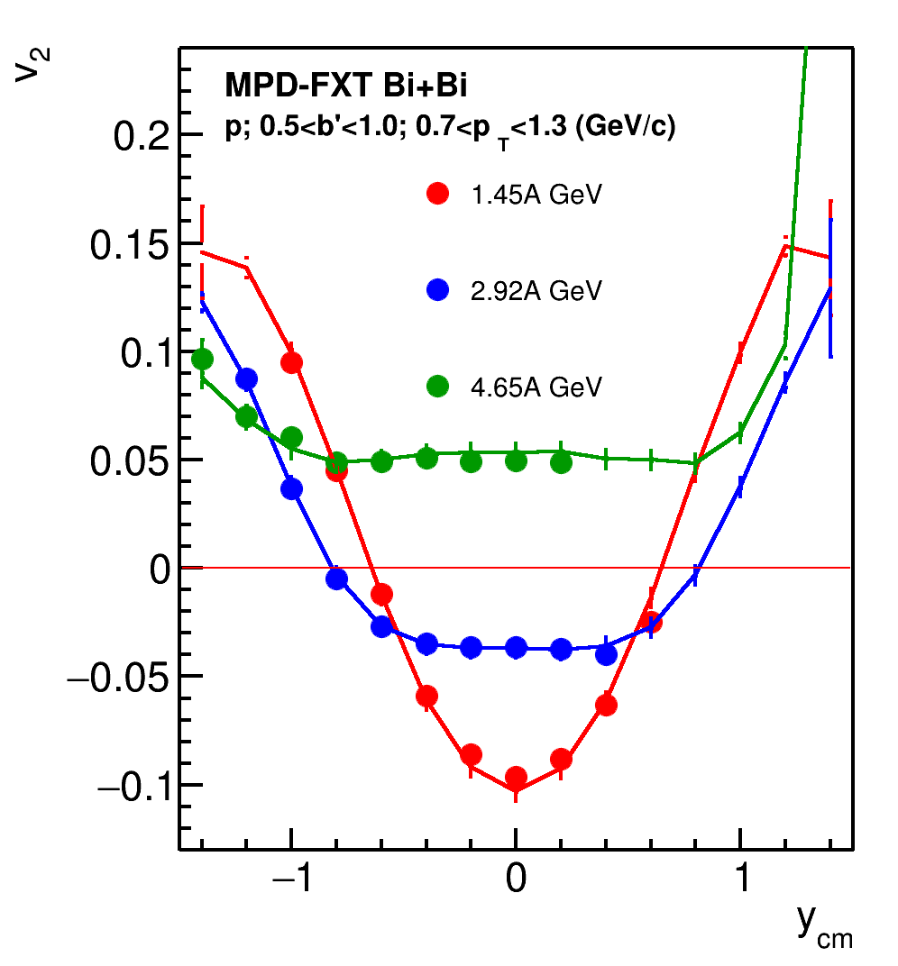
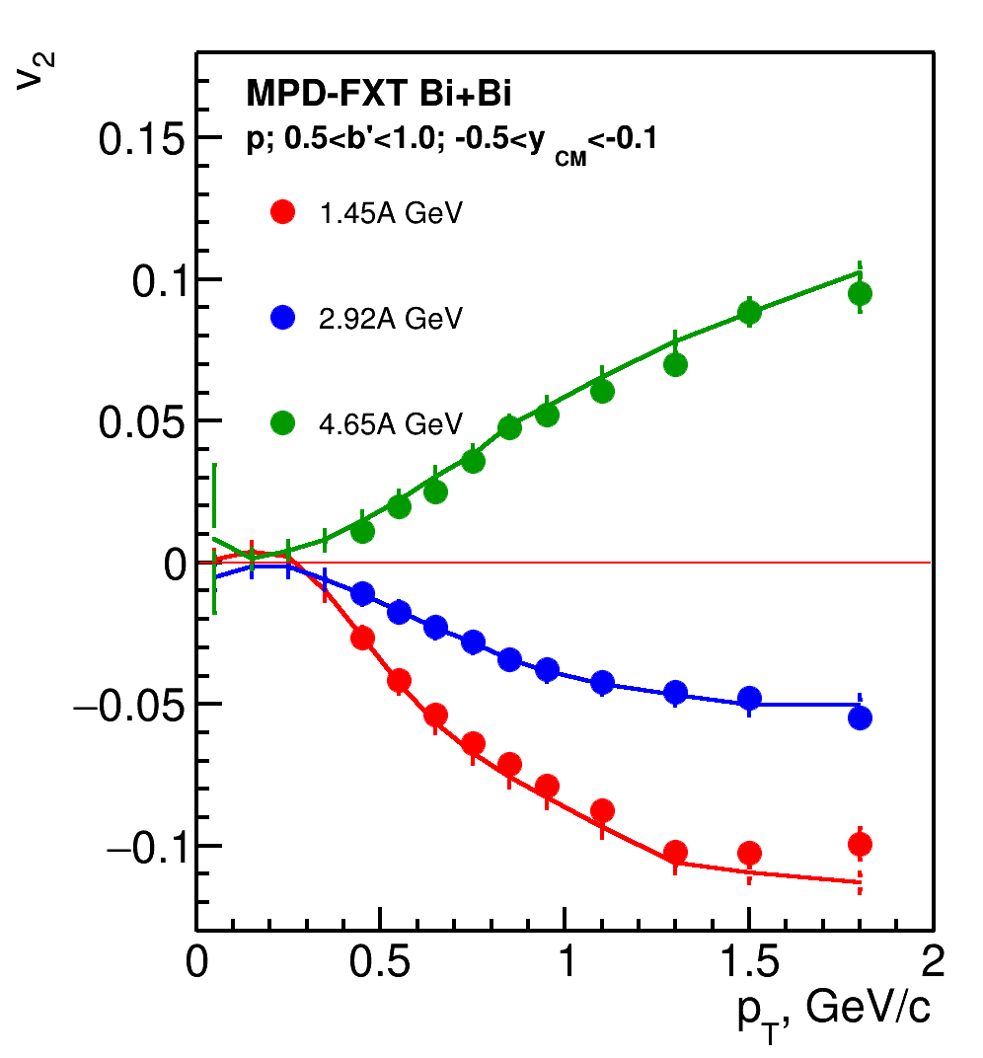
MPD-FXT feasibility studies: v_{n} measurements
Bi+Bi (UrQMD) at fixed-target → full event/detector simulation and reconstruction
MPD in fixed-target mode (MPD-FXT)
point-like target at z ~ -115 cm
Good performance for v₁, v₂ at:
E_{kin}=1.45A GeV (√s_{NN}=2.5 GeV)
E_{kin}=2.92A GeV (√s_{NN}=3 GeV)
E_{kin}=4.65A GeV (√s_{NN}=3.5 GeV)
MPD in the fixed-target mode allows differential measurements of the anisotropic flow for identified hadrons

