Slide 1
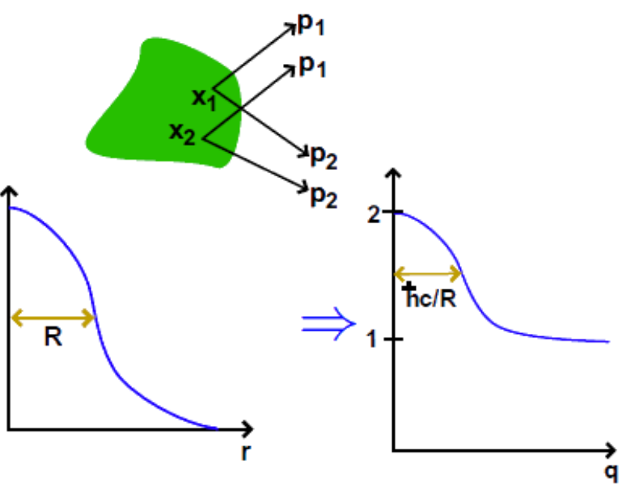
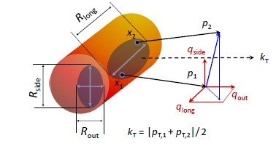
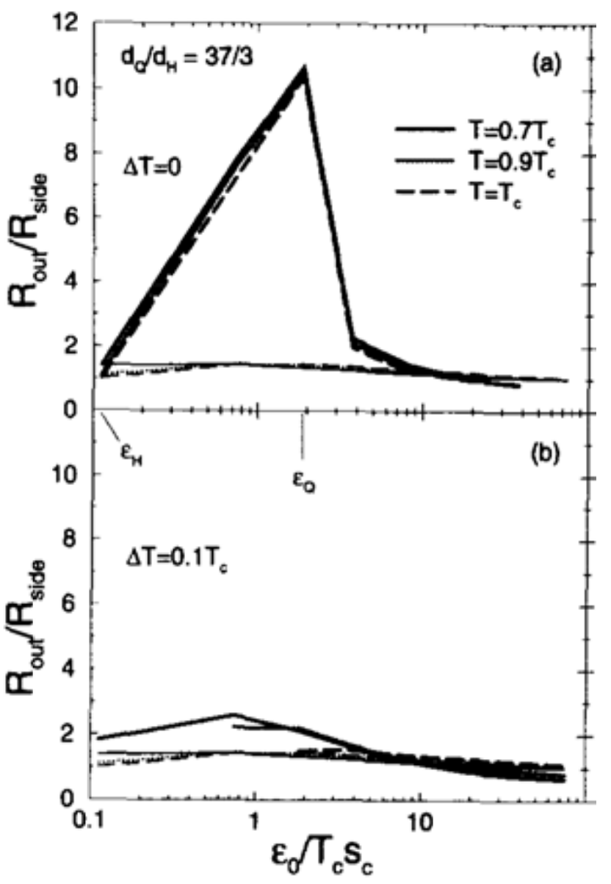
Femtoscopy with MPD at NICA
Correlation femtoscopy:
Measurement of space-time characteristics of particle production using particle correlations due to the effects of quantum statistics and final state interactions.
Correlation function:
$$C\left(p_{1},p_{2}\right)=\int{d^{4}}rS\left(r,q\right){\left|Ψ\left(r,q\right)\right|}^{2}, q=p_{1}−p_{2}, r=x_{1}−x_{2}$$
NICA
Bertch-Pratt LCMS PRC 37 (1988) 1896, PRD 33 (1986) 1314
`
NICA energy range: √sNN = 4 – 11 GeV:
first collider measurement bellow 7.7 GeV
precise measurements in a broad energy range
need for more precise measurements at low energies
precise measurements exist only with pions
need heavier particles (K, p, Λ, ...)
Rside → geometrical size
Rout → emission duration
Rlong → system lifetime
Study source radii(out,side,long) vs mT → constraint to the theoretical models (and/or EoS)
Rout/Rside → search for the 1st-order phase transition
D.H. Rischke et al. NPA 608 (1996) 479

Slide 2
Example: 3D pion radii versus mT with vHLLE+UrQMD
Model correlation functions
Comparison of extracted radii with the STAR data
(PRC 96, 024911(2017))
Femtoscopic radii are sensitive to the type of the phase transition
Crossover EoS does a better job at lowest collision energies
R_{out} (XPT) at high energies and R_{out} (1PT) at all energies are slightly overestimated
R_{out,long} (1PT) > R_{out,long} (XPT) by value of ∼1-2 fm
The difference in 1-2 fm in radii value should be measurable in the MPD

