Slide 1


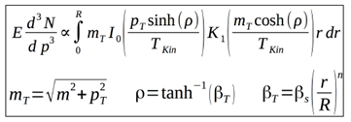
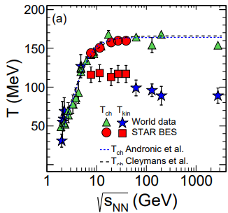
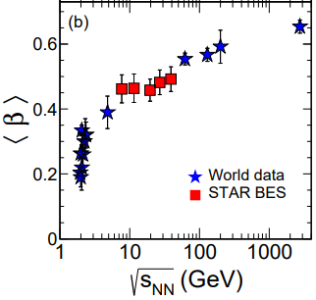
Mapping the QCD diagram
Measurements of particle differential and integrated yields are used to determine freeze-out conditions
In Statistical Model of Hadron Production, abundancy (N_{c}) of particles, which are emitted from the interaction region in statistical equilibrium with mass m and charge q, baryon number B and spin factor g = 2s+1:
, where
Particle integrated yields → determine T, μ_{B} and V as fit parameters → chemical freeze-out conditions
In a simplified hydrodynamic model, three parameters define shape of particle production spectra from a thermalized source + radial flow boost (Blast-Wave model):
  T_{Kin}: kinetic freeze out temperature
  <β_{T}>: transverse radial flow velocity
  n: velocity profile exponent
Particle p_{T}-differential spectra → determine T_{kin} and <β_{T}> as fit parameters → kinetic freeze-out conditions
Phys. Rev. C 96, 044904 (2017)
  T_{ch} increases up to 19.6 GeV and then remains constant and similar for all centralities
  T_{Kin} increases from central to peripheral collisions suggesting longer lived fireball in central collisions
  <β_{T}> descreases from central to peripheral collisions suggesting stronger expansion in central collisions

Slide 2
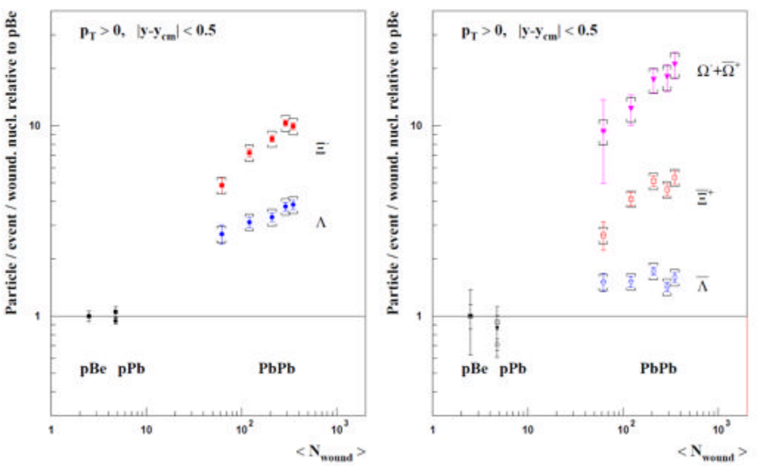
Strangeness production
Since the mid 80s, strangeness enhancement is considered as a signature of the QGP formation
Experimentally observed in heavy-ion collisions at AGS, SPS, RHIC, and LHC energies
NA57 and WA97 at SPS
RHIC/LHC
No consensus on the dominant strangeness enhancement mechanisms:
  strangeness enhancement in QGP contradicts with the observed collision energy dependence
  strangeness suppression in pp within canonical suppression models reproduces most of results except for φ(1020)
Differential measurements (vs. p_{T}, multiplicity, event shape, energy balance) of strange particles are needed in p+p, p+A and A+A collisions at NICA energies:
  excitation function of hadrons, including strangeness (yields, spectra, and ratios)
  nuclear matter EOS, in-medium effects, and chemical equilibration can be probed
  early stage and phase transformations in QCD medium

Slide 3
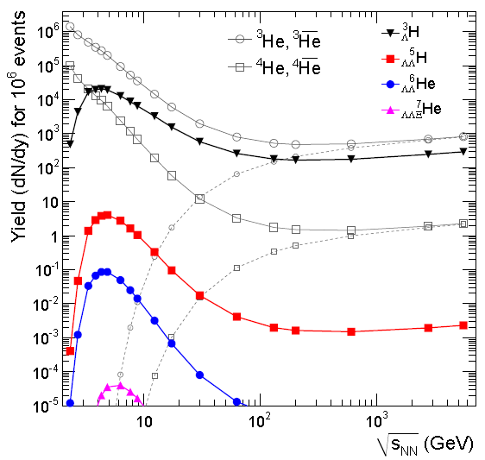

Light (hyper)nuclei
Production mechanism usually described with two classes of phenomenological models :
  statistical hadronization (SHM) → production during phase transition, dN/dy ∝ exp(-m/T_{chem} )
  coalescence → (anti)nucleons close in phase space (Δp < p₀) and matching the spin state form a nucleus
Hypernuclei measurement studies are crucial:
  microscopic production mechanism, Y-N (Y-Y, Y-N-N) potentials, strange sector of nuclear EoS
  strong implications for astronuclear physics → hyperons expected to exist in the inner core of neutron stars
Models predict enhanced hypernuclei production at NICA→ double hypernuclei are reachable
A. Andronic et al, PLB 697 (2011) 203
QM’2022
New data on yields, lifetimes and binding energies needed at NICA to provide tighter constrains

Slide 4
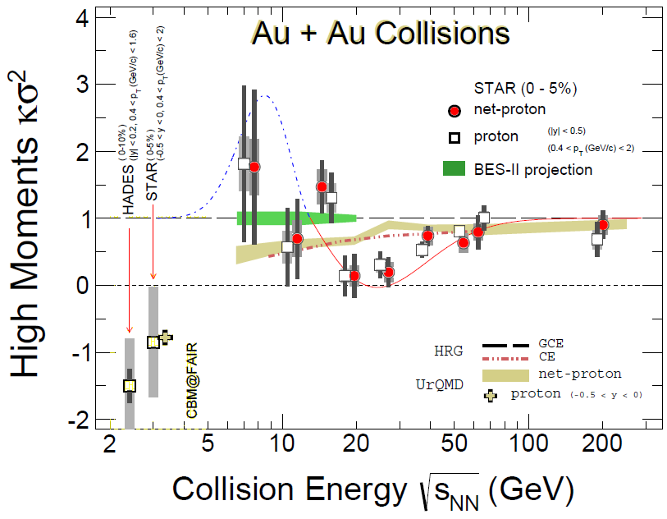
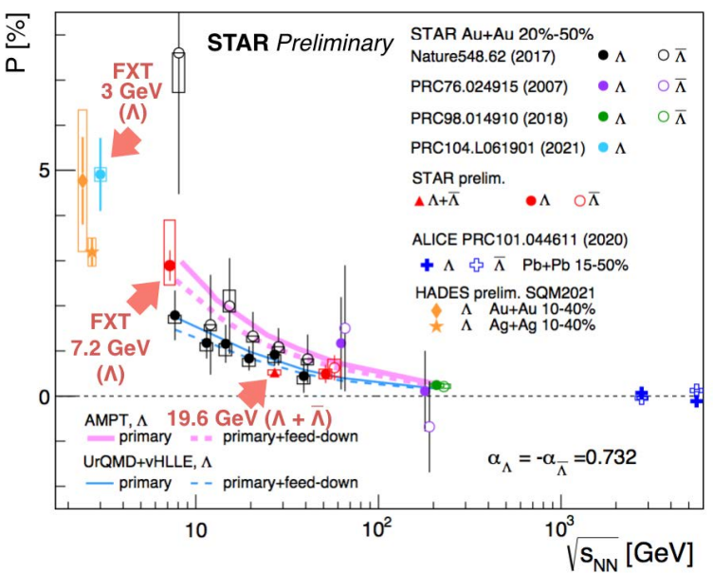
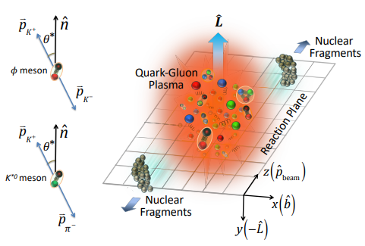
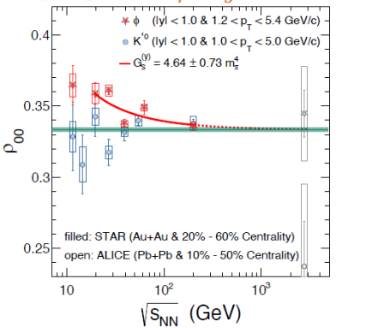

System collectivity and critical point
Critical fluctuations for (net)proton/kaon multiplicity distributions
Global hyperon polarization in mid-central A+A collisions (Λ, Ξ, Ω and antiparticles)
Spin alignment of vector mesons, K*(892) and φ(1020)
$$\frac{dN}{dcosθ}=N_{0}\left[1−ρ_{0,0}+\cos^{2}θ\left({3ρ}_{0,0}−1\right)\right]$$
Task for the MPD: extra points in the energy range 4-11 GeV with small
uncertainties to constrain model assumption

Slide 5
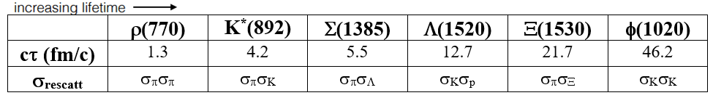
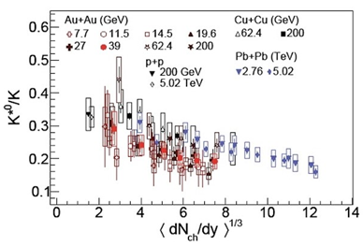
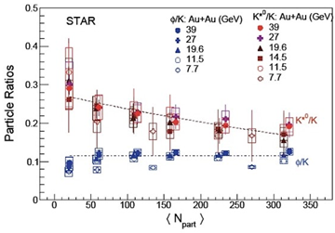
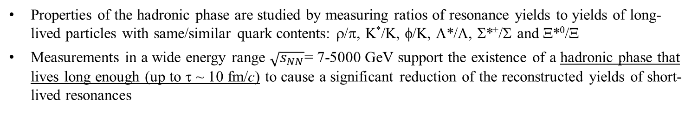
Hadronic phase
Late hadronic phase distorts signals of the early QGP state. Properties of the hadronic phase are studied by measuring properties of short-lived hadronic resonances
Final state yields of resonances depend on:
  resonance yields at chemical freeze-out
  lifetime of the resonance and the hadronic phase
  type and scattering cross sections of daughter particles
Properties of the hadronic phase are studied by measuring ratios of resonance yields to yields of long-lived particles with same/similar quark contents: ρ/π, K*/K, φ/K, Λ*/Λ, Σ*±/Σ and Ξ*⁰/Ξ
Measurements in a wide energy range $\sqrt{s_{NN}}$= 7-5000 GeV support the existence of a hadronic phase that lives long enough (up to τ ~ 10 fm/c) to cause a significant reduction of the reconstructed yields of short-lived resonances
All emulators/models of the hadronic phase should be tuned to reproduce measurements for resonances
All model predictions for the early QGP phase must be filtered through the hadronic phase

Slide 6
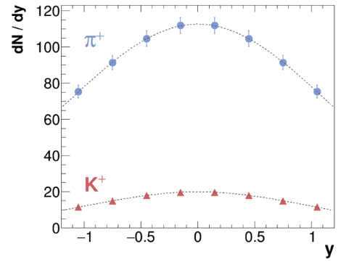
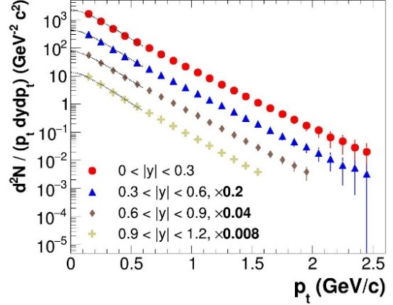
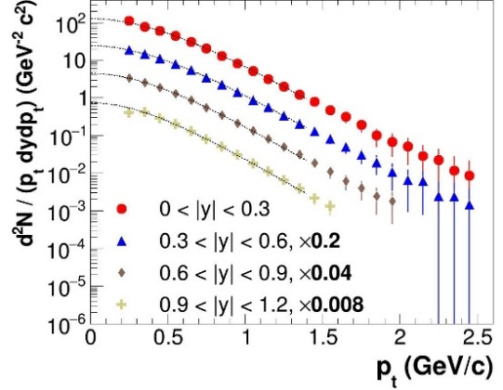
MPD capabilities: light identified hadrons
Charged hadrons: large and homogeneous acceptance + excellent PID capabilities of the TPC and TOF:
    samples phase space corresponding to ~ 70% of the π/K/p production
    hadron spectra are measured from p_{T} ~ 0.1 GeV/c
0-5% central AuAu@9 GeV (PHSD) → full event/detector simulation and reconstruction
Phys.Part.Nucl. 53 (2022) 2, 203-206
π⁺
K⁺
Neutral mesons (π⁰, η, K_{s}, ω, η’): ECAL reconstruction + photon conversion method (PCM) :
  extend p_{T} ranges of charged particle measurements
  different systematics
  MPD will be able to measure differential production spectra, integrated yields and <p_{T}>,
  particle ratios for a wide variety of identified hadrons (π, K, η, ω, p, η’)

Slide 7
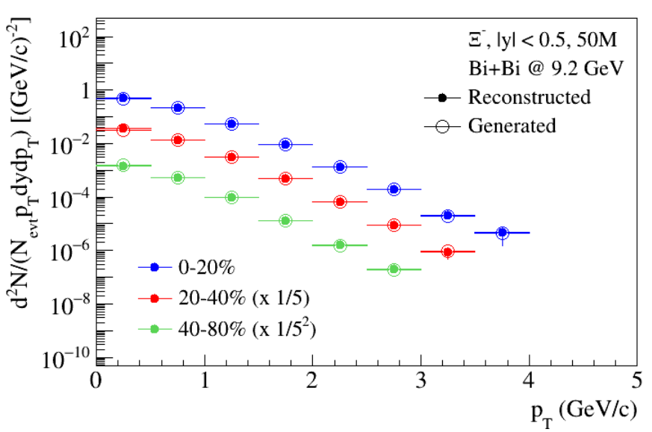
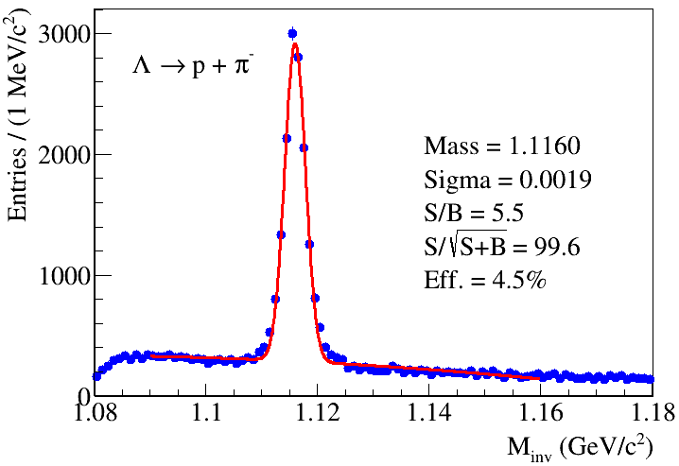
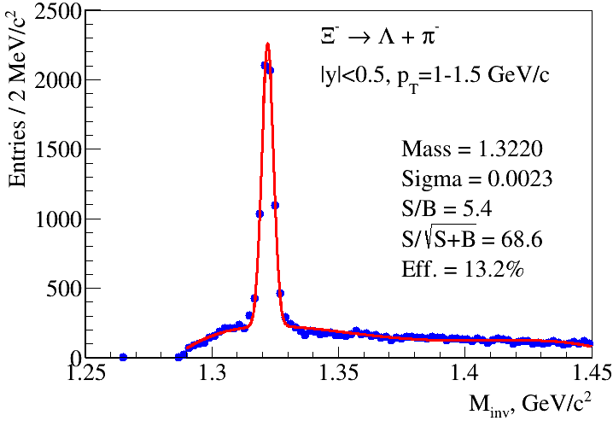
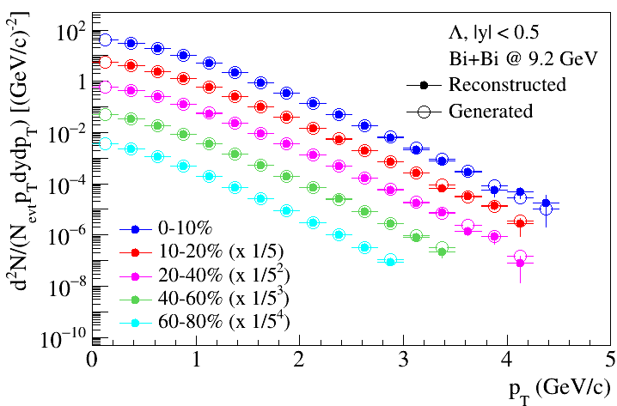
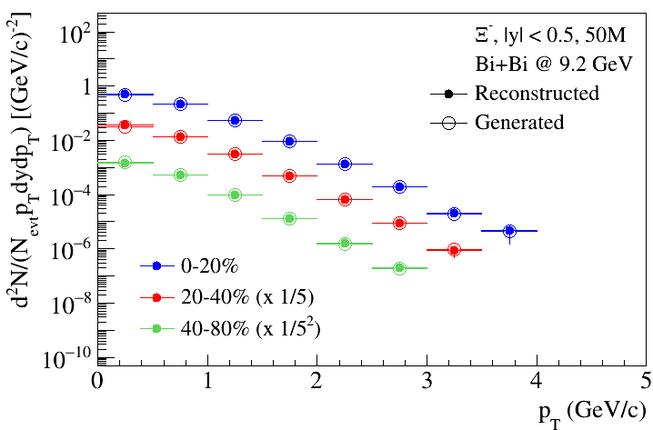
MPD capabilities: (multi)strange baryons
Good phase-space coverage for (multi)strange baryons, large signal-to-background ratios due to the secondary vertex reconstruction (topology selections) in the TPC and hadron identification
BiBi@9.2 GeV (UrQMD), 10 M events
MPD will provide measurements of strange kaons, (multi)strange baryons and resonances
in p+p, p+A and A+A collisions at NICA energies

Slide 8
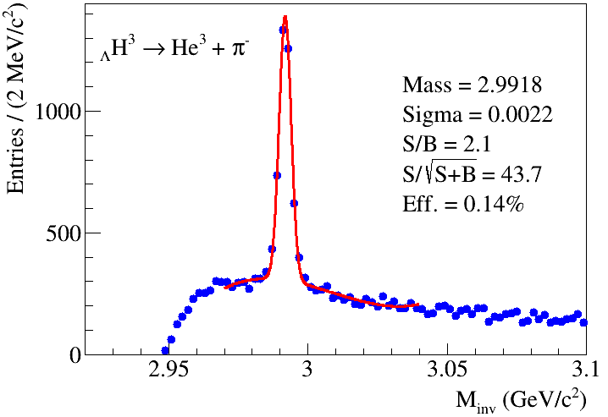
MPD capabilities: light (hyper)nuclei
Charged particle tracking and excellent particle identification capabilities allow reconstruction of hadrons
Future high-statistics runs from NICA/MPD will provide measurements of several hypernuclear species to better constrain hypernuclei production models in the high baryon density regime
Phys.Part.Nucl.Lett. 19 (2022) 1, 46-53

Slide 9
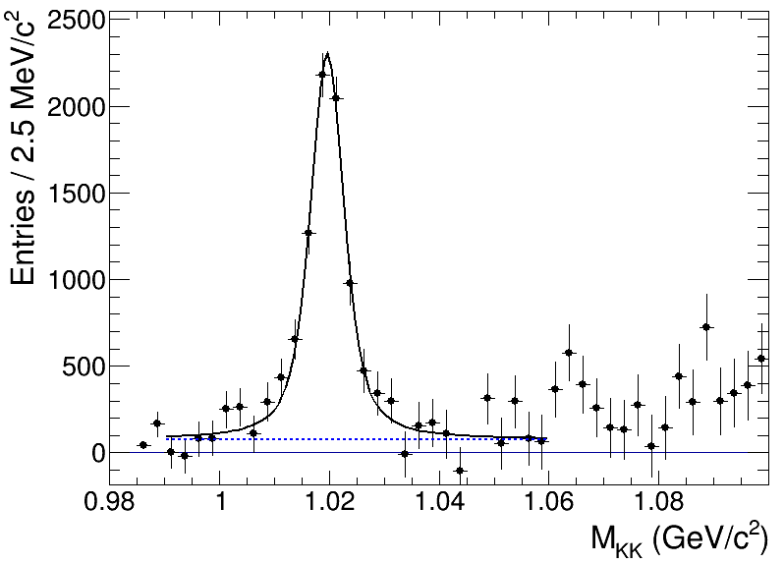
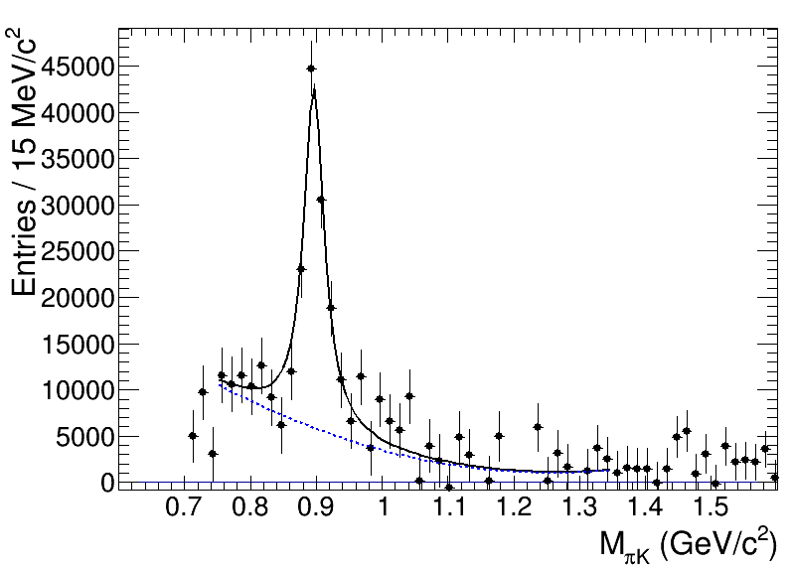
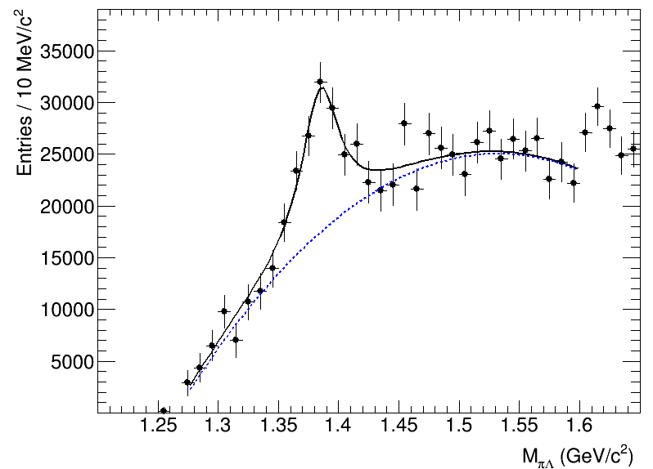
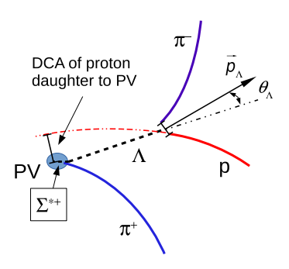
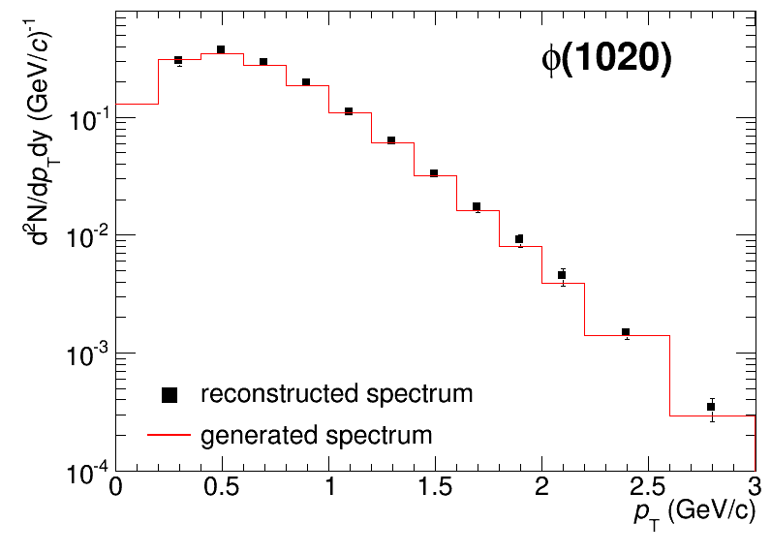
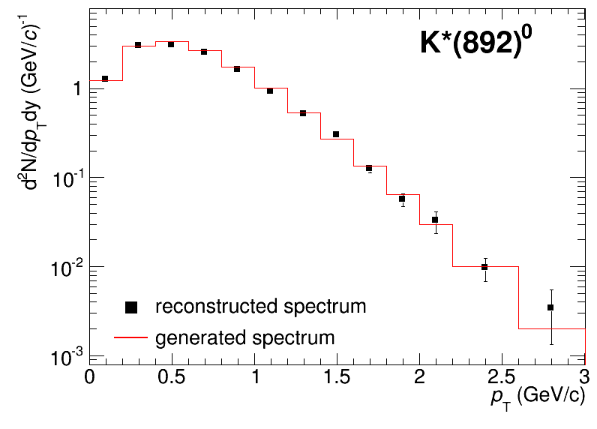
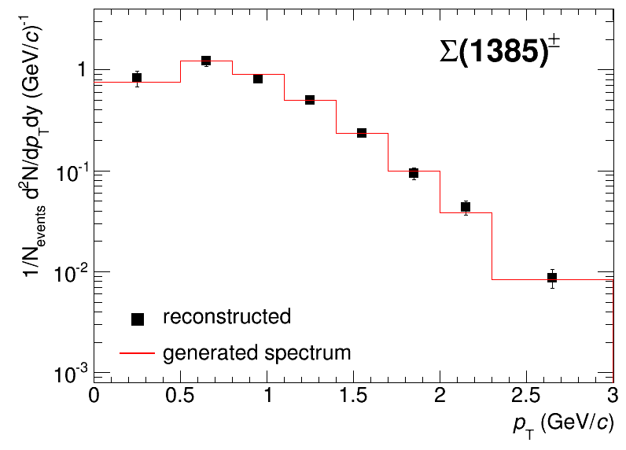
MPD capabilities: hadronic resonances
MPD can reconstruct signals from resonance decays using combined charged hadron identification in the TPC and TOF, weakly decaying daughters require additional second vertex and topology selections
BiBi@9.2 GeV (UrQMD), 10 M events after mixed-event background subtraction
φ(1020) → K⁺K⁻
K*(892)⁰ → π±K±
Σ(1385)± → π±Λ (Λ→pπ)
Reconstructed spectra match the generated ones within uncertainties
Measurements are possible starting from ~ zero momentum → sample most of the yields

