Slide 1
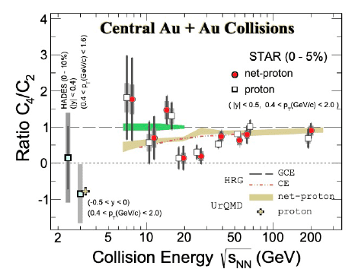
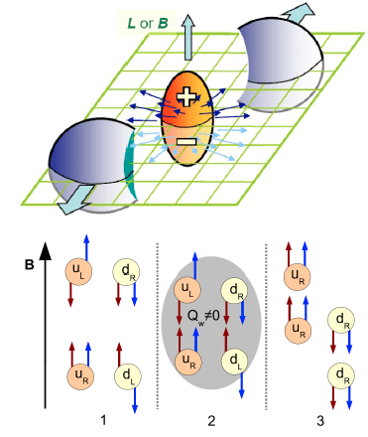
Global observables with MPD at high μ_{B}
Hot topics :
--- Search for QCD critical point and non-monotonic energy dependence of net-proton kσ² =C₄/C₂ for 5% most central events;
--- Chiral magnetic effect search in isobar collisions: charge separation due to anomaly induced chiral imbalance and large (10¹⁵ T) magnetic field. The Chiral Magnetic Effect can only operate in the deconfined, chirally symmetric phase. See search for CME in arxiv.2109.00131:
Φ*= Φ-Ψ_{RP}, with Φ and Φ_{RP} being the azimuthal angle of a particle and of the Reaction Plane (RP).
The “γ correlator: γ_{αβ} = 〈cos(φ_{α} + φ_{β} − 2Ψ_{RP}). Here φ_{α} and φ_{β} are the azimuthal angles of particles of interest (POIs).
Both items require precise event centrality and reaction plane (RP) definition
D.Kharzeev, arXiv:1312.3348

Slide 2
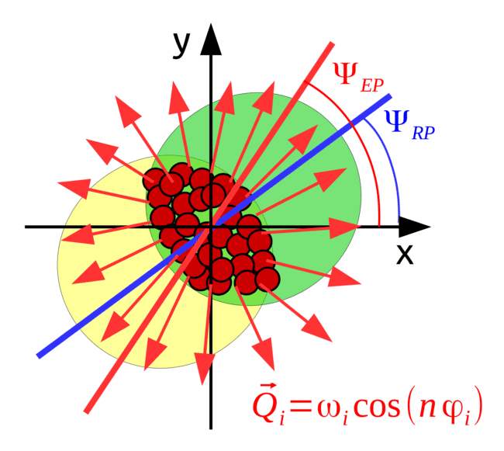
Global observables: reaction plane
Reaction plane (RP) – plane formed by impact parameter b and beam line
RP cannot be measured in the experiment since we cannot measure or control b
Event plane (EP) is the observable estimation of the reaction plane
c

Slide 3
Global observables: collision centrality
Two major type of centrality estimators
Mindapidity
Forward rapidity

Slide 4
Event centrality by TPC multiplicity
Broad distribution in any impact parameter class (interval of b) selected even via very narrow multiplicity interval
This might result in dominating volume fluctuations

Slide 5
Event centrality by FHCAL
Possibility to mismatch centrality classes from very central with very peripheral events
Broad distribution in any impact parameter class selected via FHCal energy
Combination of several observables/proxies of centrality – work is in progress by the MPD

