Slide 1
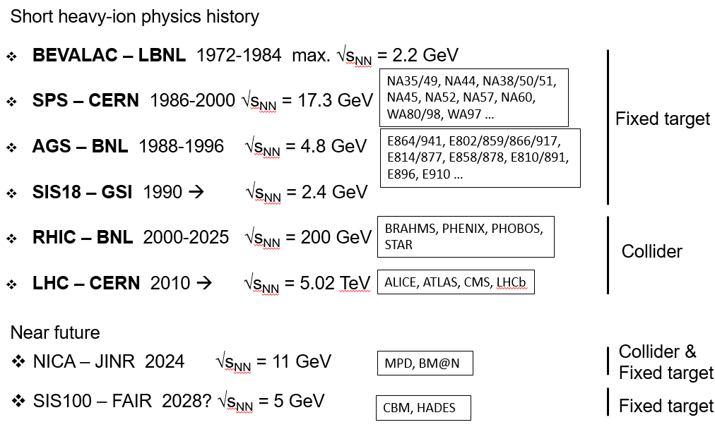
Relativistic heavy-ion collisions

Slide 2
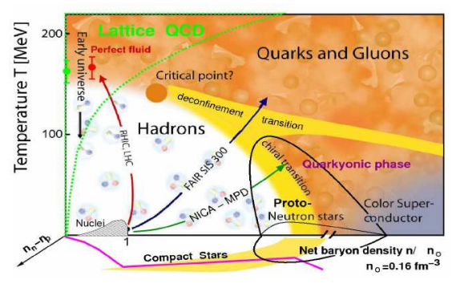
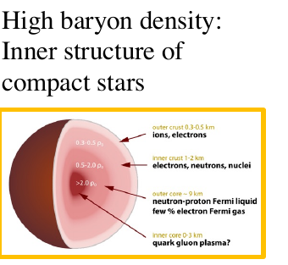
NICA is a quark-baryonic bridge to neutron stars
Heavy-ion collisions are used to:
study QCD under extreme conditions of high temperatures and densities
explore the QCD phase diagram, search for the QGP and study its properties
Why Quark-gluon plasma is of interest?
primordial form of QCD matter at high temperatures and/or (net)baryon densities
present during the first microseconds after Big Bang and in cores of the compact neutron stars / mergers
provides important insights on the origin of mass for matter, and how quarks are confined into hadrons
Heavy-ion collisions at NICA create extremely dense matter at moderate temperatures:
net baryon density (n) up to 10 times that in normal nuclear matter (n₀)
baryonic chemical potential μ_{B} = (300 - 600) MeV, T_{ch} ~ (120-150) MeV
Comparable baryon density may exist in cores of compact neutron stars and in neutron star mergers

Slide 3
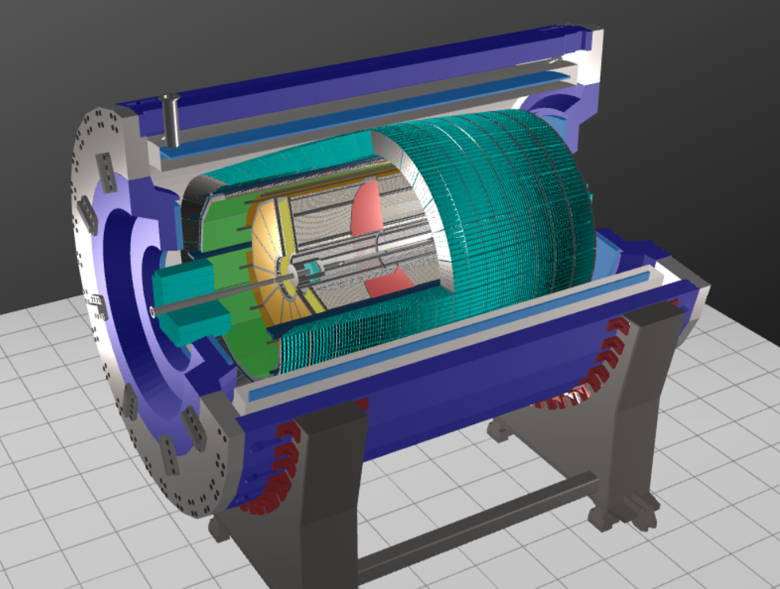
Multi-Purpose Detector
TPC: |Δϕ| < 2π, |η| ≤ 1.6
TOF, EMC: |Δϕ| < 2π, |η| ≤ 1.4
FFD: |Δϕ| < 2π, 2.9 < |η| < 3.3
FHCAL: |Δϕ| < 2π, 2 < |η| < 5
TPC: charged particle tracking + momentum measurements + identification by dE/dx
TOF: charged particle identification by m²/β
EMC: energy and PID for γ/e± + charged particle identification (limited ability)
FFD/FHCAL: event triggering, event geometry, T₀
ITS: secondary vertex reconstruction for heavy-flavor decays (very small S/B ratio)

Slide 4
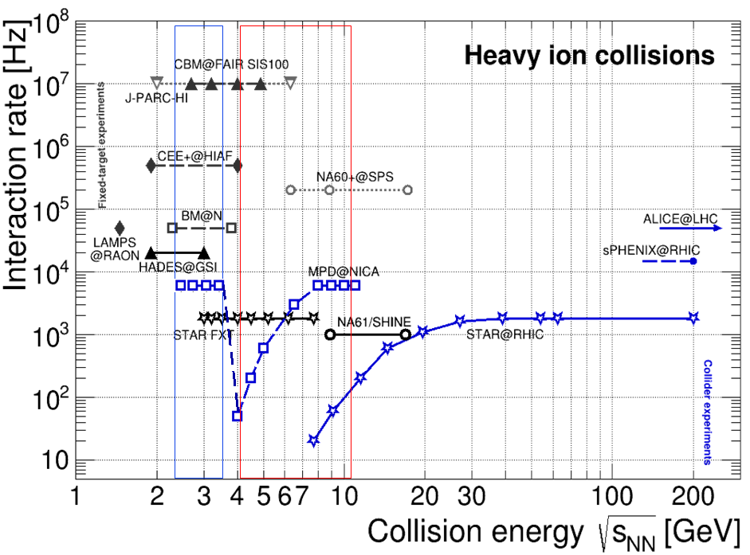
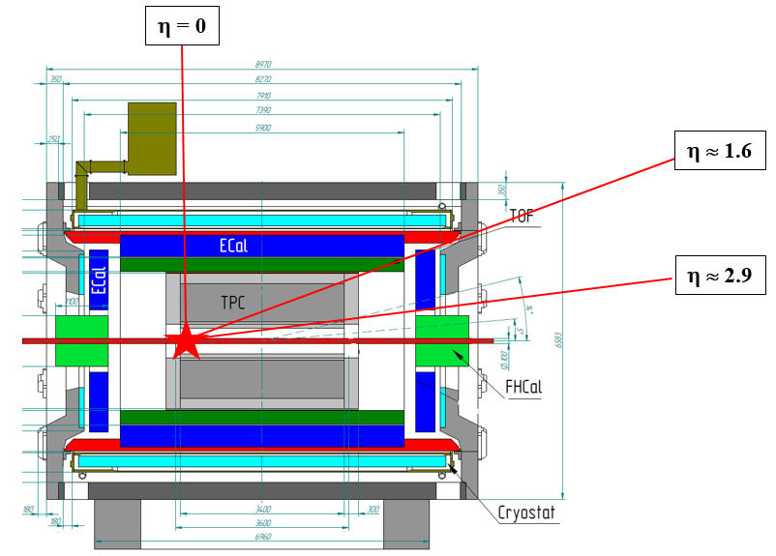
NICA operation modes: collider and fixed-target
With a wire-target at z ~ -100 cm
Discussing the option of NICA operation in the collider and fixed-target modes in the same campaign
Fixed-target mode: one beam + thin wire (~ 100 μm) close to the edge of the MPD central barrel:
extends energy range of MPD to √s_{NN} = 2.4-3.5 GeV (overlap with HADES, BM@N and CBM)
solves problem of low event rate at lower collision energies (only ~ 50 Hz at √s_{NN} = 4 GeV at design luminosity)
backup start-up solution (too low luminosity, only one beam, etc.)
Unique capability of target and collision energy overlap between the experiments at NICA

Slide 5
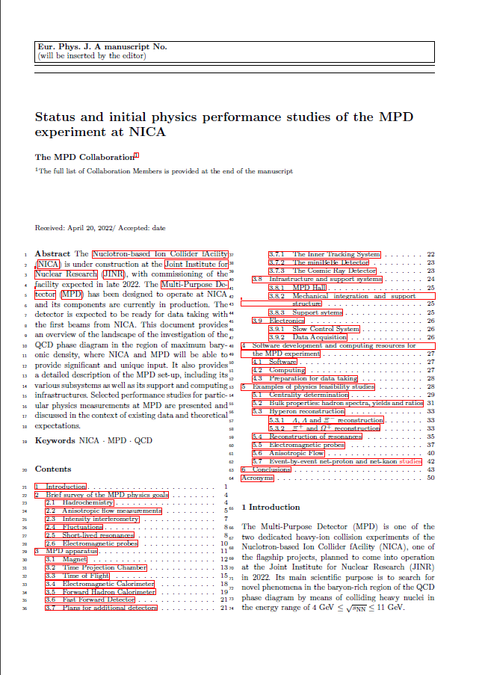
Collaboration activity
MPD publications: over 200 in total for hardware, software and physics studies (SPIRES)
MPD @ conferences: presented at all major conferences in the field
First collaboration paper recently published EPJA (~ 50 pages): Eur.Phys.J.A 58 (2022) 7, 140
Status and initial physics performance studies of the MPD experiment at NICA

Slide 6
MPD physics program
G. Feofilov, A. Aparin
V. Kolesnikov, Xianglei Zhu
K. Mikhailov, A. Taranenko
Global observables
Total event multiplicity
Total event energy
Centrality determination
Total cross-section measurement
Event plane measurement at all rapidities
Spectator measurement
Spectra of light flavor and hypernuclei
Light flavor spectra
Hyperons and hypernuclei
Total particle yields and yield ratios
Kinematic and chemical properties of the event
Mapping QCD Phase Diag.
Correlations and Fluctuations
Collective flow for hadrons
Vorticity, Λ polarization
E-by-E fluctuation of
multiplicity, momentum and
conserved quantities
Femtoscopy
Forward-Backward corr.
Jet-like correlations
D. Peresunko, Chi Yang
Wangmei Zha, A. Zinchenko
Electromagnetic probes
Electromagnetic calorimeter meas.
Photons in ECAL and central barrel
Low mass dilepton spectra in-medium modification of resonances and intermediate mass region
Heavy flavor
Study of open charm production
Charmonium with ECAL and central barrel
Charmed meson through secondary vertices in ITS and HF electrons
Explore production at charm threshold

Slide 7
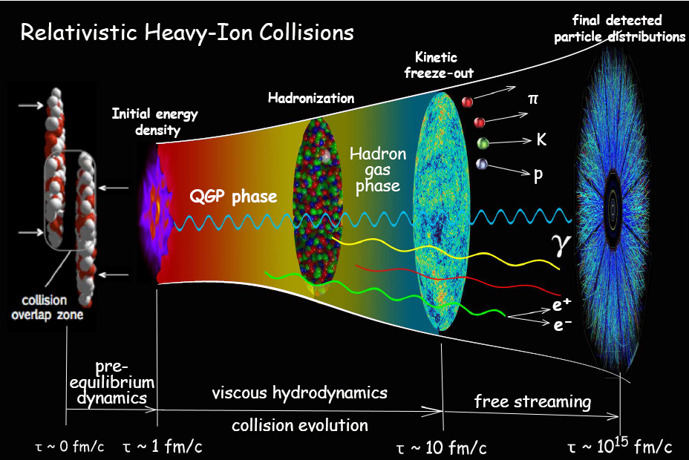
System evolution in heavy-ion collisions
Fireball is ~10⁻¹⁵ meters across and lives for 5x10⁻²³ seconds
Initial state
QGP as a relativistic
fluid
The measurements are used to infer properties of the early state of relativistic heavy-ion collisions
Only final state particles are measured in the detector: γ, e±, μ±, π⁰, π±, K⁰, K±, η, ω, p, $\overline{p}$, φ, Λ, Σ, Ξ, etc.
The measurements are used to infer properties of the early state of relativistic heavy-ion collisions

