Slide 1
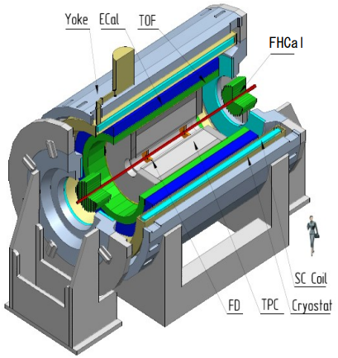
Multi-Purpose Detector (MPD) Collaboration
MPD International Collaboration was established in 2018
to construct, commission and operate the detector
10 Countries, >450 participants, 31 Institutes and JINR
Organization
Acting Spokesperson: Victor Riabov
Deputy Spokesperson: Zebo Tang
Institutional Board Chair: Alejandro Ayala
Project Manager: Slava Golovatyuk
Joint Institute for Nuclear Research;
AANL, Yerevan, Armenia;
University of Plovdiv, Bulgaria;
Tsinghua University, Beijing, China;
USTC, Hefei, China;
Huzhou University, Huizhou, China;
Institute of Nuclear and Applied Physics, CAS, Shanghai, China;
Central China Normal University, China;
Shandong University, Shandong, China;
IHEP, Beijing, China;
University of South China, China;
Three Gorges University, China;
Institute of Modern Physics of CAS, Lanzhou, China;
Tbilisi State University, Tbilisi, Georgia;
FCFM-BUAP (Heber Zepeda) Puebla, Mexico;
FC-UCOL (Maria Elena Tejeda), Colima, Mexico;
FCFM-UAS (Isabel Dominguez), Culiacán, Mexico;
ICN-UNAM (Alejandro Ayala), Mexico City, Mexico;
Institute of Applied Physics, Chisinev, Moldova;
Institute of Physics and Technology, Mongolia;
Belgorod National Research University, Russia;
INR RAS, Moscow, Russia;
MEPhI, Moscow, Russia;
Moscow Institute of Science and Technology, Russia;
North Osetian State University, Russia;
NRC Kurchatov Institute, ITEP, Russia;
Kurchatov Institute, Moscow, Russia;
St. Petersburg State University, Russia;
SINP, Moscow, Russia;
PNPI, Gatchina, Russia;
Vinča Institute of Nuclear Sciences, Serbia;
Pavol Jozef Šafárik University, Košice, Slovakia

