Slide 1
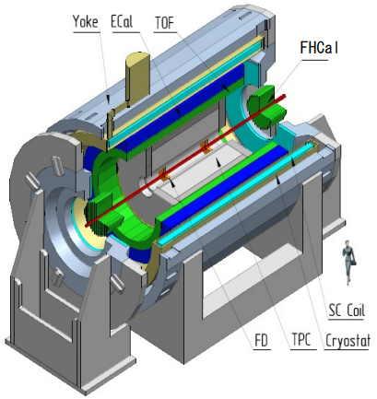
Multi-Purpose Detector (MPD) Collaboration
MPD International Collaboration was established in 2018
to construct, commission and operate the detector
12 Countries, >500 participants, 39 Institutes and JINR
Organization
Acting Spokesperson: Victor Riabov
Deputy Spokespersons: Zebo Tang, Arkadiy Taranenko
Institutional Board Chair: Alejandro Ayala
Project Manager: Slava Golovatyuk
Joint Institute for Nuclear Research, Dubna;
A.Alikhanyan National Lab of Armenia, Yerevan, Armenia;
SSI “Joint Institute for Energy and Nuclear Research – Sosny” of the National Academy of Sciences of Belarus, Minsk, Belarus
University of Plovdiv, Bulgaria;
Tsinghua University, Beijing, China;
University of Science and Technology of China, Hefei, China;
Huzhou University, Huzhou, China;
Institute of Nuclear and Applied Physics, CAS, Shanghai, China;
Central China Normal University, China;
Shandong University, Shandong, China;
University of Chinese Academy of Sciences, Beijing, China;
University of South China, China;
Three Gorges University, China;
Institute of Modern Physics of CAS, Lanzhou, China;
Tbilisi State University, Tbilisi, Georgia;
Institute of Physics and Technology, Almaty, Kazakhstan;
Benemérita Universidad Autónoma de Puebla, Mexico;
Centro de Investigación y de Estudios Avanzados, Mexico;
Instituto de Ciencias Nucleares, UNAM, Mexico;
Universidad Autónoma de Sinaloa, Mexico;
Universidad Autónoma Metropolitana, Mexico;
Universidad de Colima, Mexico;
Universidad de Sonora, Mexico;
Universidad Michoacana de San Nicolás de Hidalgo, Mexico
Institute of Applied Physics, Chisinev, Moldova;
Institute of Physics and Technology, Mongolia;
Belgorod National Research University, Russia;
D.V.Skobeltsyn Institute of Nuclear Physics, Moscow, Russia;
High School of Economics University, Moscow, Russia;
Institute for Nuclear Research of the RAS, Moscow, Russia;
Moscow Institute of Physics and Technology, Russia;
National Research Nuclear University MEPhI , Moscow, Russia;
National Research Center "Kurchatov Institute", Russia;
North Osetian State University, Russia;
Peter the Great St. Petersburg Polytechnic University Saint Petersburg, Russia;
Petersburg Nuclear Physics Institute, Gatchina, Russia;
Plekhanov Russian University of Economics, Moscow, Russia;
SaintPetersburg State University, Russia;
Vinča Institute of Nuclear Sciences, Serbia;
Pavol Jozef Šafárik University, Košice, Slovakia

